Slide 1
DSAI 5203: Brain-Inspired Computing Tutorial 1: Review on Calculus and Linear Algebra
Xiang Hao
Department: DSAI
Email: xiang.hao@connect.polyu.hk
Notes:
Hello everyone, welcome to today's tutorial. I am Xiang Hao from the DSAI department. Today, we are going to review two important mathematical tools: Calculus and Linear Algebra. These tools are the foundation of this course, 'Brain-Inspired Computing.' If you have any questions after class, please feel free to email me. My email address is on the slide. So, let's get started.

Slide 2
Part 1: Review on Linear Algebra
Notes:
"First, let's look at Part 1. We will focus on Linear Algebra. I know many of you learned this in your first or second year. However, it is very important to refresh your memory. In this part, we will discuss the basic concepts and why they are useful for machine learning."

Slide 3
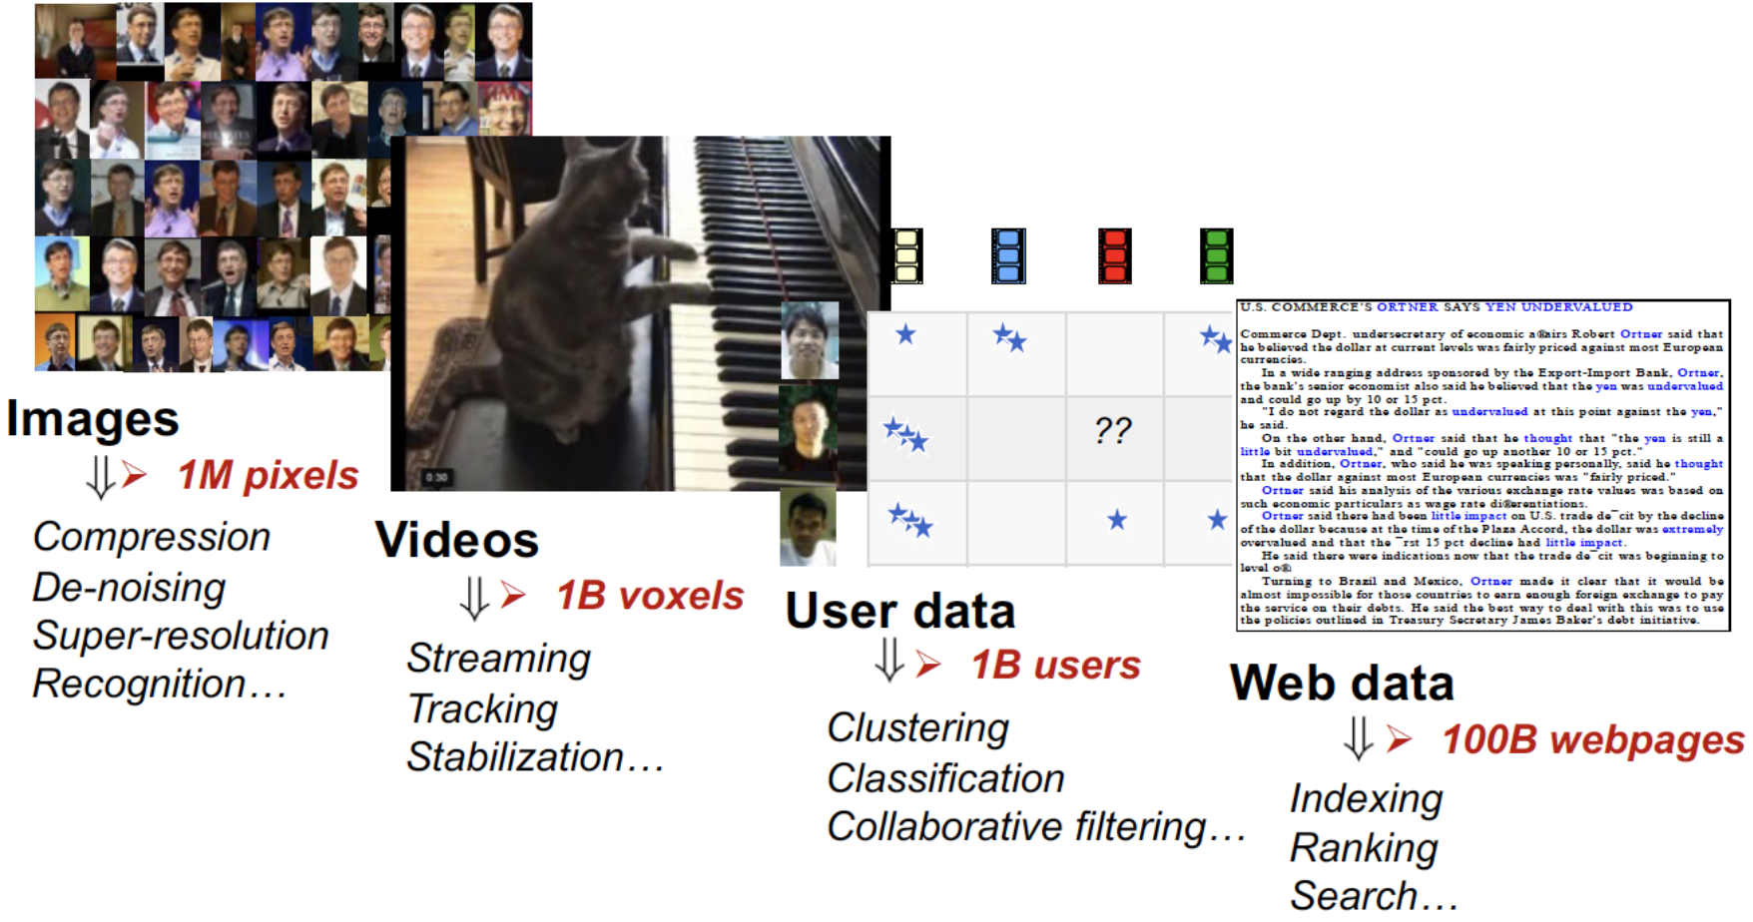
The Roles of Linear Algebra in ML&DA
Understanding Multidimensional Data
The language for describing and manipulating multidimensional data structures.
Notes:
"So, why is Linear Algebra important? Basically, it is the language of data. In Machine Learning and Data Analytics, we often deal with multidimensional data. Linear Algebra gives us a way to describe this data clearly. It also gives us a way to manipulate, or change, this data structure. Without Linear Algebra, it is very hard to handle complex data."

Slide 4
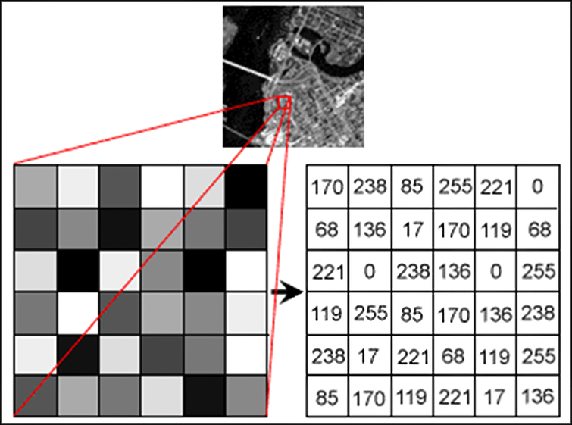
The Roles of Linear Algebra in ML&DA
Understanding Multidimensional Data
The language for describing and manipulating multidimensional data structures.
Key Concept
Vectors: Data points or features can be represented as vectors.
Matrices: Data or datasets are often represented as matrices, with rows corresponding to individual records and columns to features.
House ID | Size | Num Room | Price (m$)
1 | 150 | 3 | 3.6
2 | 200 | 4 | 4.3
N | 64 | 2 | 1.7
Notes:
"Now, let's look at two key concepts: Vectors and Matrices. Please look at the table on the right. First, Vectors. A vector represents a single data point. For example, one row in this table can be a vector. Second, Matrices. A matrix represents the whole dataset. In this table, the rows are the individual records, and the columns are the features, like Price or Size. So, we use matrices to organize our data."

Slide 5
Why do we care about linear algebra?
Linear algebra is the mathematics of arrays
The language for describing and manipulating multidimensional data structures.
The core operation in linear algebra is matrix multiplication
{Dot, scalar, inner} product
Correlation/covariance
Linear regression
Logistic regression
Principal components analysis
Discrete Fourier transform (JPEG)
PageRank
Hidden layers of neural nets
Convolutions
Newton/L-BFGS
Notes:
"So, why do we care about Linear Algebra in this course? There is a simple reason: Linear Algebra is the mathematics of arrays. In computer science, we use arrays everywhere. The core operation in Linear Algebra is matrix multiplication. Many famous algorithms rely on this operation. If you understand matrix multiplication, you can understand how these algorithms work."

Slide 6
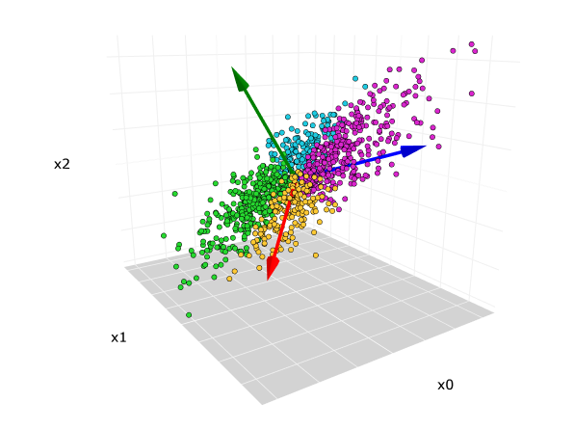
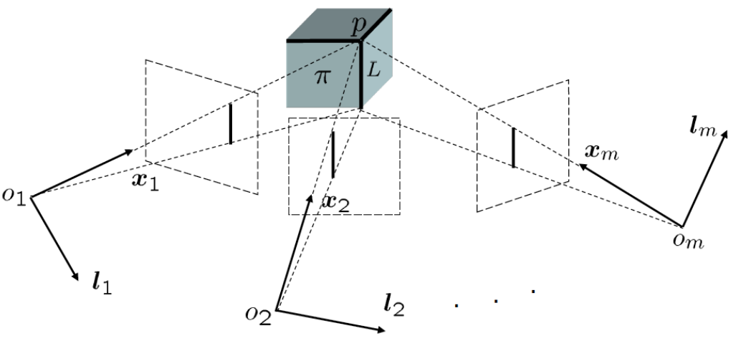
Why do we care about linear algebra?
Linear algebra is the mathematics of arrays
The language for describing and manipulating multidimensional data structures.
The core operation in linear algebra is matrix multiplication
{Dot, scalar, inner} product
Correlation/covariance
Linear regression
Logistic regression
Principal components analysis
Discrete Fourier transform (JPEG)
PageRank
Hidden layers of neural nets
Convolutions
Newton/L-BFGS
Principal Components Analysis, PCA
Multi-view Learning
Notes:
"Let's look at some specific examples. Here is a list of applications that use matrix multiplication. For example, we use it in Linear Regression and Logistic Regression. We also use it in Principal Components Analysis (PCA). Most importantly for this course, it is used in Neural Networks and Convolutions. So, Linear Algebra is everywhere in AI."

Slide 7
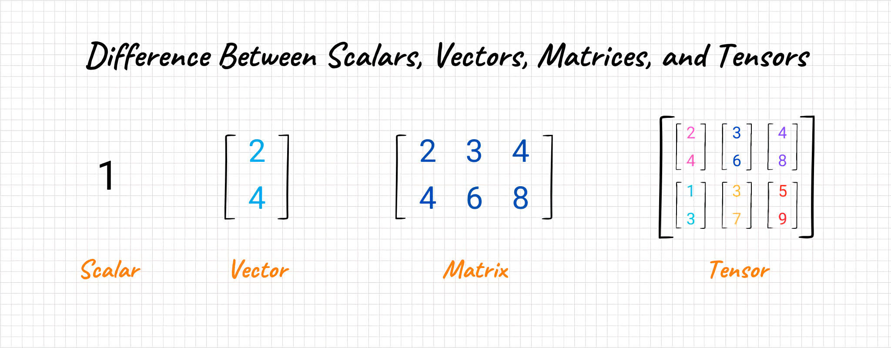
Overview

Slide 8
Overview
Linear algebra is more like programming!
Matrices are Functions, Shapes are Types,
and Multiplication is Composition.
Notes:
"This is an interesting perspective. Actually, Linear Algebra is very similar to programming. We can think of a Matrix as a Function. It does something to the data. We can think of Matrix Multiplication as Function Composition. It combines different steps. If you are good at coding, this way of thinking might help you understand the math better.“
"This is similar to..." (这类似于……) / "We can think of A as B" (我们可以把A看作B)

Slide 9
Content
Vector
Definition
Properties
Operations
Matrix
Definition
Properties
Operations
Notes:
"Now, let's look at the content of our review today. We will divide the review into two main sections. The first section is about Vectors. In this section, we will cover the definition, the properties, and the basic operations of vectors. We need to understand vectors before we can understand matrices."

Slide 10
Content
Vector
Definition
Properties
Operations
Matrix
Definition
Properties
Operations

Slide 11
What is a Vector?
A vector is an ordered list of numbers, such as
$$\left({1 \atop \begin{aligned}3 \\ 2 \\ 4\end{aligned}}\right)$$
$\left(1 3 2 4\right)$
or
Notes:
"First, let's ask a basic question: What is a vector? From a mathematical perspective, the definition is simple. A vector is just an ordered list of numbers. Please look at the slide. We can write it vertically, like a column. This is called a Column Vector. Or, we can write it horizontally, like a row. This is called a Row Vector. In computer science, we usually treat them as arrays."

Slide 12
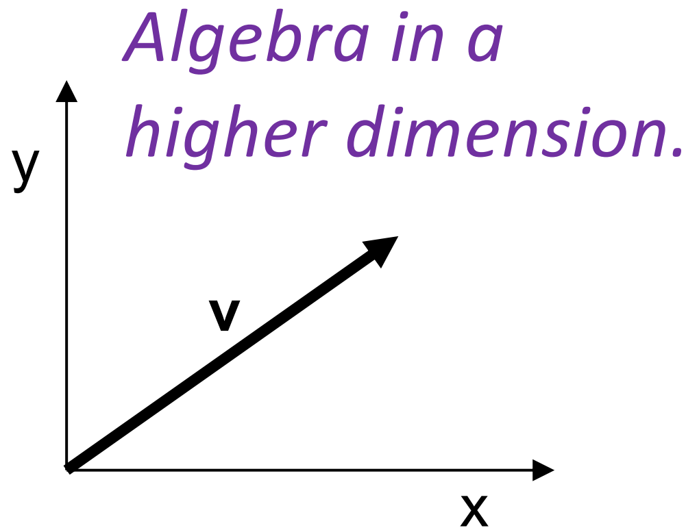
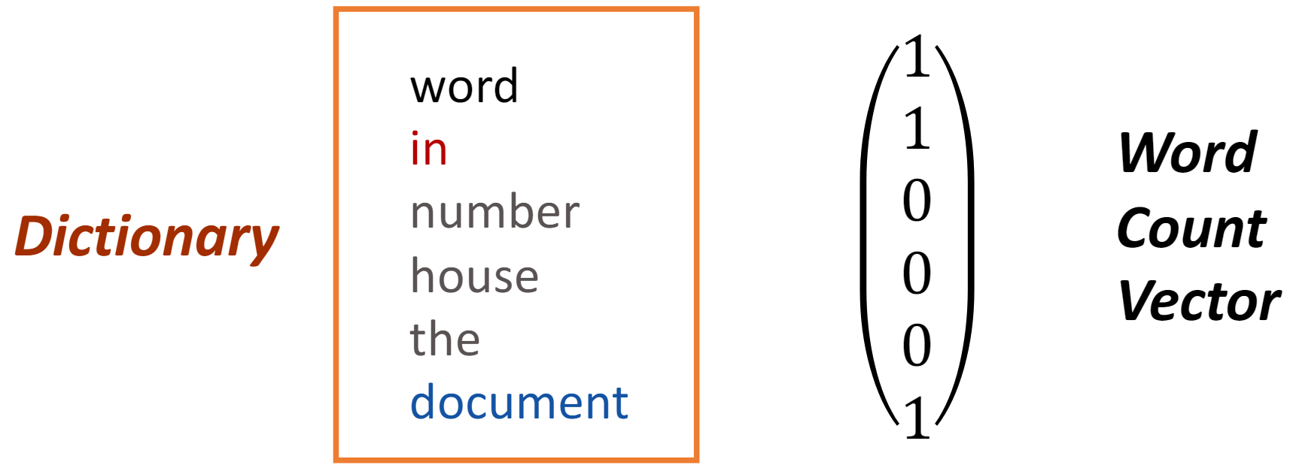
What is a Vector?
A vector is an ordered list of numbers, such as
$$\left({1 \atop \begin{aligned}3 \\ 2 \\ 4\end{aligned}}\right)$$
$\left(1 3 2 4\right)$
or
A vector is a quantity or phenomenon that has two independent properties: magnitude and direction.
Example of Vector used in Machine Learning
Notes:
"However, there is another definition. In physics, a vector is something that has magnitude (size) and direction. But in Machine Learning, we don't always think about physics. In Machine Learning, we use vectors to represent features. For example, if you want to sentence.

Slide 13
Vector Arithmetic
Size of a vector: The size of a vector refers to its dimension, which is the number of elements it contains.
$$\left({1 \atop \begin{aligned}3 \\ 2 \\ 4\end{aligned}}\right)$$
$\left(1 3 2 4\right)$
or
vector $x∈$ $ℝ^{n}$
Notes:
"Now, let's talk about Vector Arithmetic. The first concept is the Size of a vector. Sometimes we also call it the Dimension. This is very easy to understand. The size is simply the number of elements inside the vector. For example, if a vector has 4 numbers, its dimension is 4. We often write this as $R^{n}$, where $n$is the size."

Slide 14
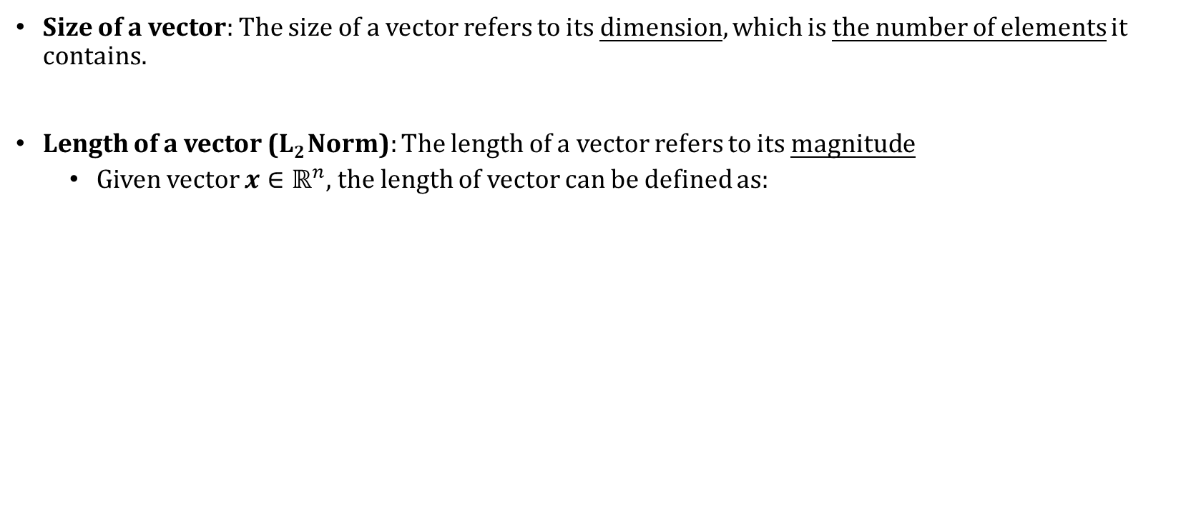
Vector Arithmetic
Size of a vector: The size of a vector refers to its dimension, which is the number of elements it contains.
Length of a vector (L₂ Norm): The length of a vector refers to its magnitude
Given vector $x∈$ $ℝ^{n}$, the length of vector can be defined as:
$$\left\|x\right\|=\sqrt{x_{1}^{2}+x_{2}^{2}+…+x_{n}^{2}}$$
Notes:
"The second concept is the Length of a vector. Please be careful here. 'Length' is different from 'Size'. In mathematics, we call the length the L2 Norm or the Magnitude. How do we calculate it? We calculate the square root of the sum of the squared elements. Essentially, it measures how 'long' the arrow is in space."

Slide 15
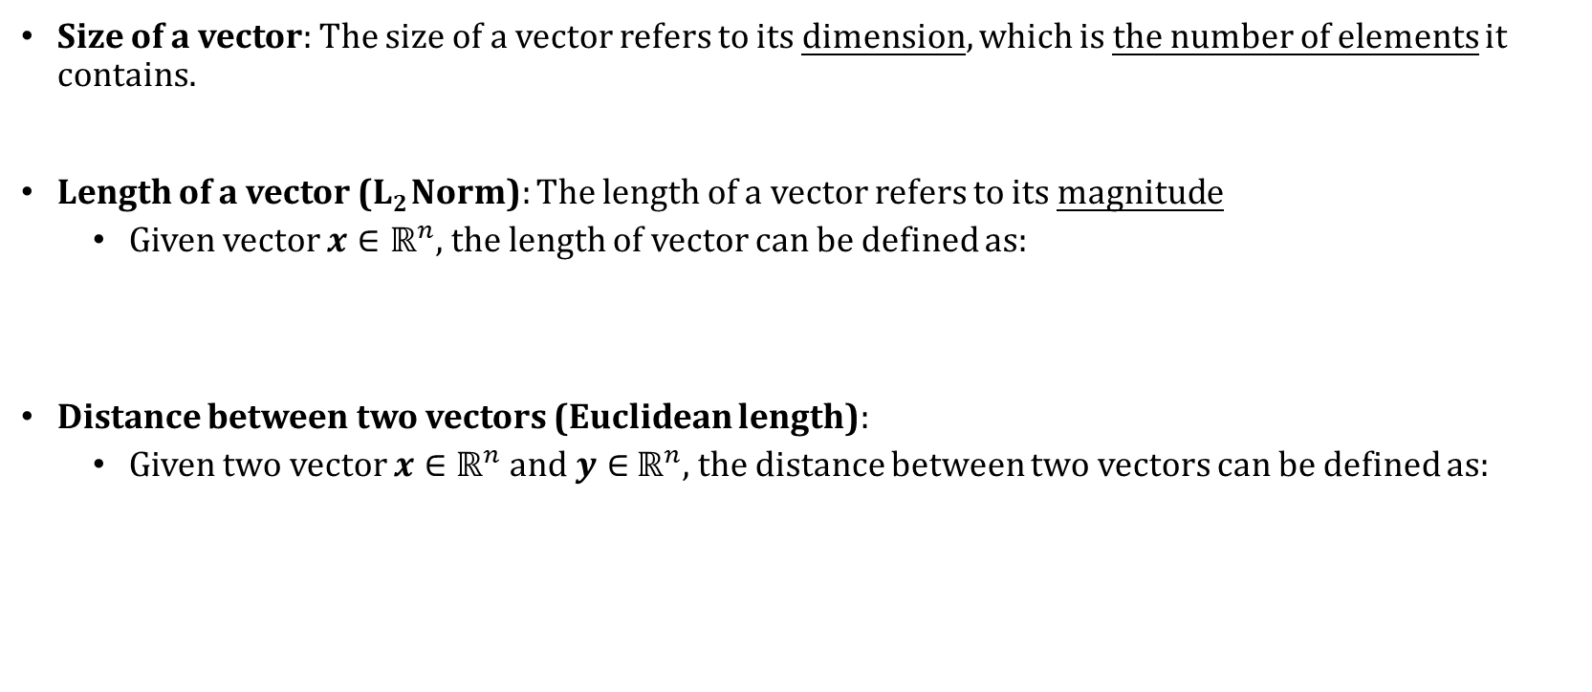
Vector Arithmetic
Size of a vector: The size of a vector refers to its dimension, which is the number of elements it contains.
Length of a vector (L₂ Norm): The length of a vector refers to its magnitude
Given vector $x∈$ $ℝ^{n}$, the length of vector can be defined as:
Distance between two vectors (Euclidean length):
Given two vector $x∈$ $ℝ^{n}$and $y∈$ $ℝ^{n}$, the distance between two vectors can be defined as:
$$\left\|x\right\|=\sqrt{x_{1}^{2}+x_{2}^{2}+…+x_{n}^{2}}$$
$$\left\|x−y\right\|=\sqrt{{\left(x_{1}−y_{1}\right)}^{2}+{\left(x_{2}−y_{2}\right)}^{2}+…+{\left(x_{n}−y_{n}\right)}^{2}}$$
Notes:
"Next, let's look at the Distance between two vectors. We call this the Euclidean Distance. If we have vector $x$and vector $y$, how far apart are they? The formula is very similar to the length formula. We calculate the length of the difference between $x$and $y$. This concept is very important for clustering algorithms like K-Means.“ Just keep in mind here this minus.

Slide 16
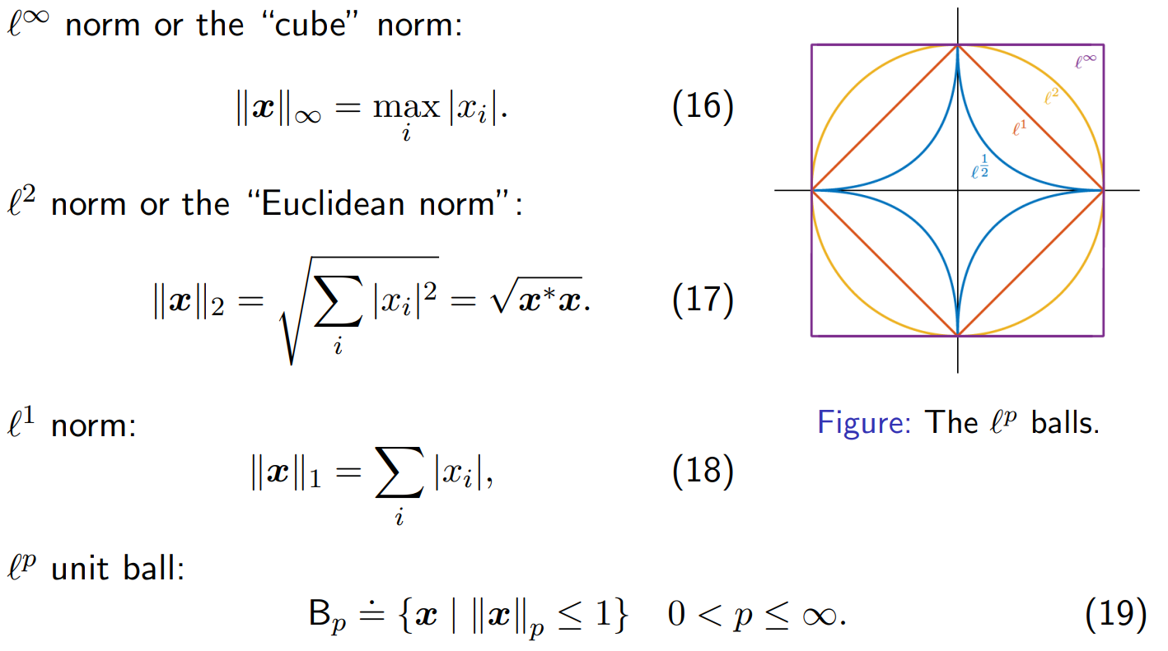
Beyond Euclidean distance
Notes:
"However, Euclidean distance is not the only way to measure distance. This slide is titled Beyond Euclidean Distance. Depending on your data, you might need other metrics. For example, in some cases, we use Manhattan Distance or Cosine Similarity. But for this tutorial, we will focus mainly on Euclidean distance. Just keep in mind that other options exist."

Slide 17
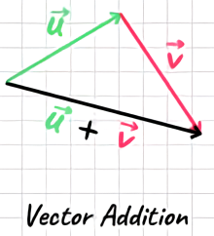
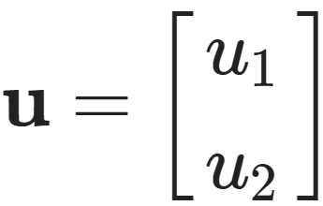
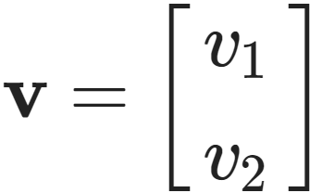
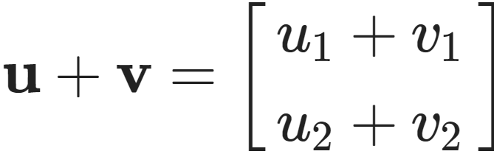
Vector Arithmetic
Vector Addition:
For two vectors and
Their addition is
Notes:
"Now, let's move on to vector operations. The first one is Vector Addition. This is very straightforward. If we want to add two vectors, we simply add their corresponding elements. For example, the first element plus the first element, and the second plus the second. Note that the two vectors must have the same size."

Slide 18
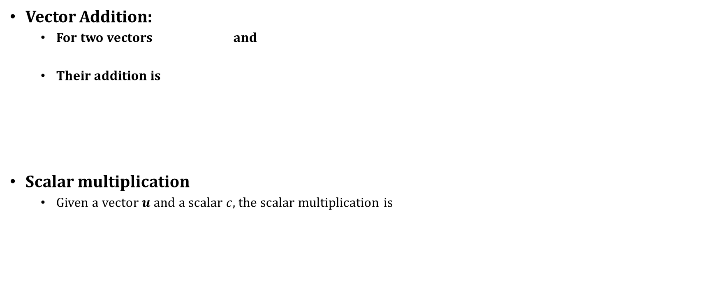
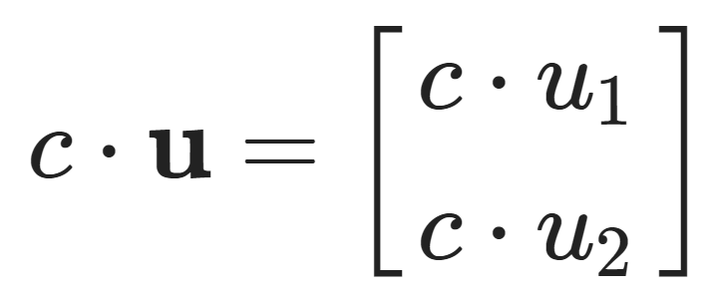
Vector Arithmetic
Vector Addition:
For two vectors and
Their addition is
Scalar multiplication
Given a vector $u$ and a scalar $c$, the scalar multiplication is
Notes:
"The next operation is Scalar Multiplication. Here, 'Scalar' just means a single number. If we have a vector $u$and a scalar $c$, what do we do? We multiply every element in the vector by this number $c$. This operation changes the magnitude of the vector, but usually keeps the same direction."

Slide 19
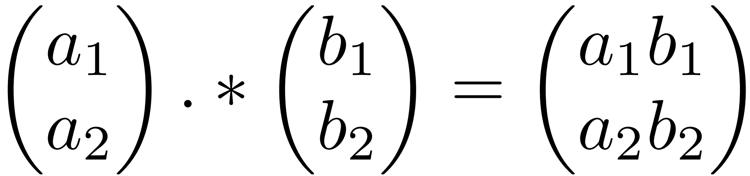
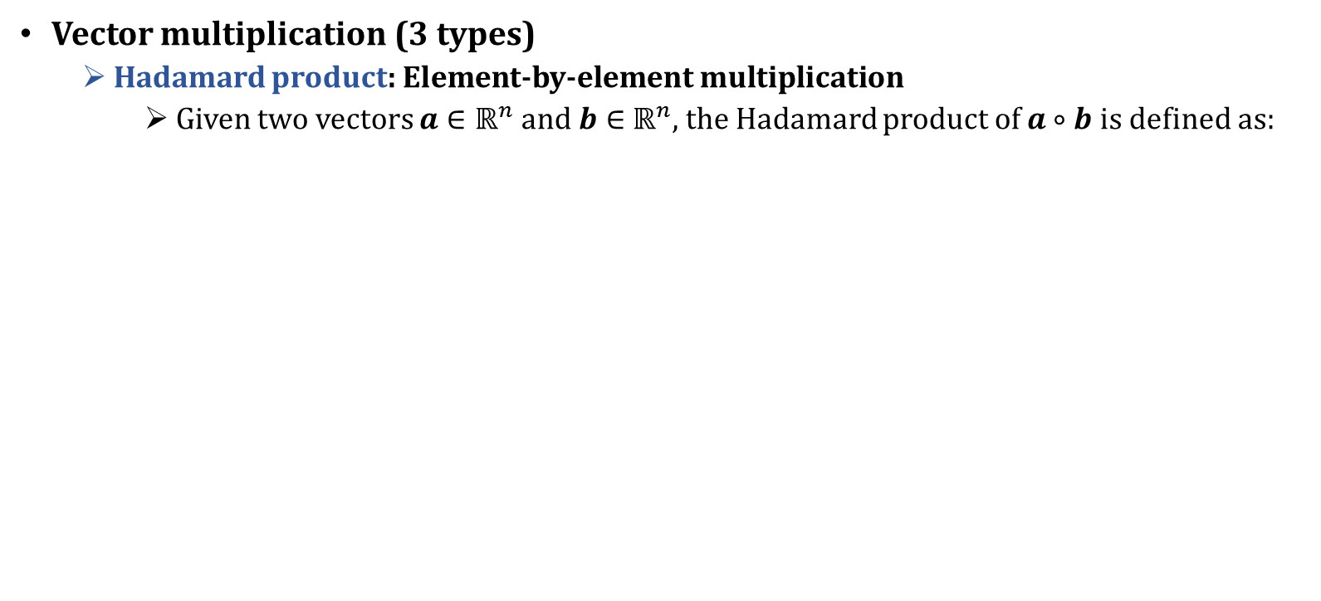
Vector Arithmetic
Vector multiplication (3 types)
Hadamard product: Element-by-element multiplication
Given two vectors $a∈$ $ℝ^{n}$and $b∈$ $ℝ^{n}$, the Hadamard product of $a∘b$ is defined as:
$${\left(a∘b\right)}_{i}={\left(a\right)}_{i}∘{\left(b\right)}_{i}$$
Example of Hadamard product
Notes:
"Now, Vector Multiplication is a bit more complex because there are three types. Let's look at the first type: the Hadamard Product. This is also called element-wise multiplication. It is denoted by a small circle symbol ($∘$). Just like addition, we simply multiply the corresponding elements. $a_{1}$times $b_{1}$, $a_{2}$times $b_{2}$, and so on."

Slide 20
Vector Arithmetic
Vector multiplication:
Hadamard product: Element-by-element multiplication
Given two vectors $a∈$ $ℝ^{n}$and $b∈$ $ℝ^{n}$, the Hadamard product of $a∘b$ is defined as:
Dot product (Inner product)
Given two vectors $a∈$ $ℝ^{n}$and $b∈$ $ℝ^{n}$, the dot product can be defined as:
$${\left(a∘b\right)}_{i}={\left(a\right)}_{i}∘{\left(b\right)}_{i}$$
Example of Hadamard product
$$a⋅b=a_{1}b_{1}+a_{2}b_{2}+…+a_{n}b_{n}=\sum_{i=1}^{n}{a_{i}b_{i}}$$
Notes:
"The second type is the Dot Product, or Inner Product. This is the most important operation in this section. Please pay attention to the result. The result of a dot product is a Scalar (a single number), not a vector. We calculate it by multiplying corresponding elements and then summing them all up. We use this to calculate projections and similarity."

Slide 21
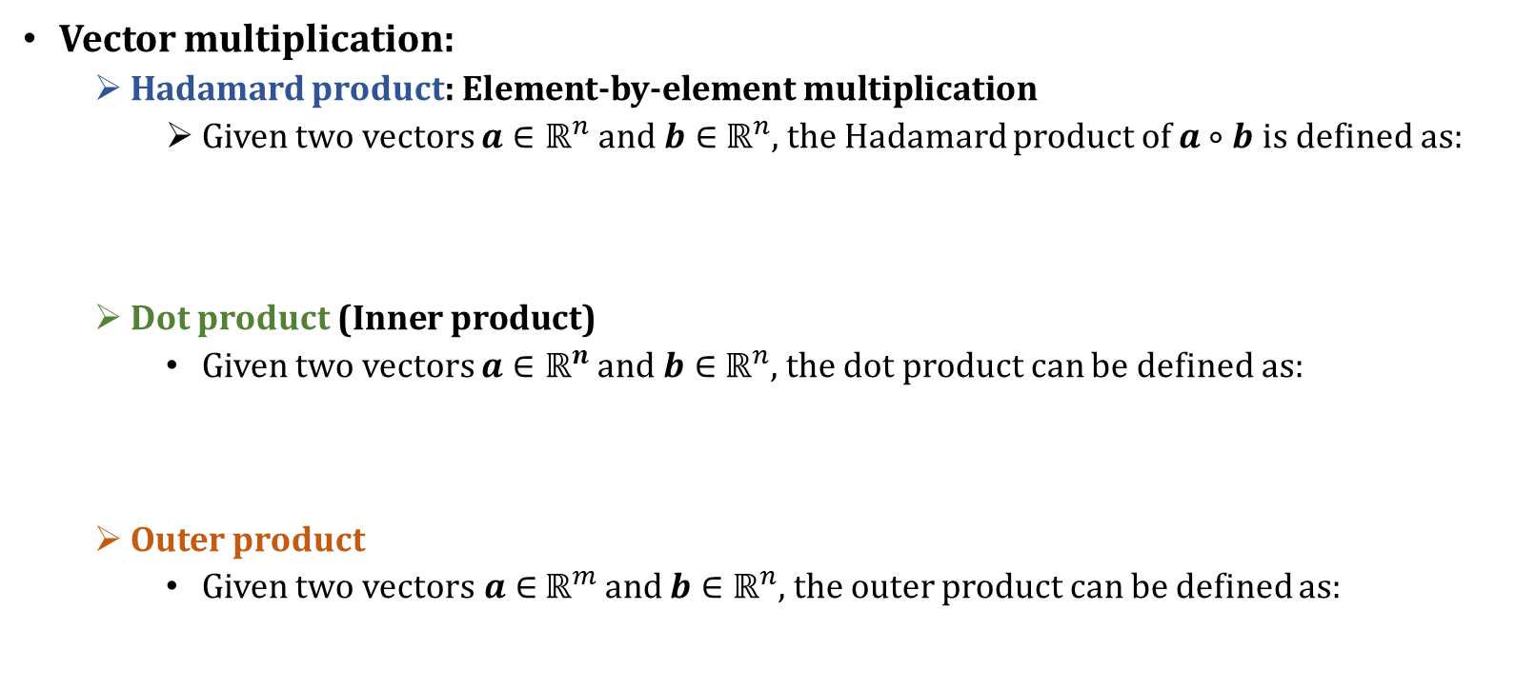

Vector Arithmetic
Vector multiplication:
Hadamard product: Element-by-element multiplication
Given two vectors $a∈$ $ℝ^{n}$and $b∈$ $ℝ^{n}$, the Hadamard product of $a∘b$ is defined as:
Dot product (Inner product)
Given two vectors $a∈$ $ℝ^{n}$and $b∈$ $ℝ^{n}$, the dot product can be defined as:
Outer product
Given two vectors$a∈$ $ℝ^{m×1}$ and $b∈$ $ℝ^{n×1}$, the outer product can be defined as:
$${\left(a∘b\right)}_{i}={\left(a\right)}_{i}∘{\left(b\right)}_{i}$$
Example of Hadamard product
$$a⋅b=a_{1}b_{1}+a_{2}b_{2}+…+a_{n}b_{n}=\sum_{i=1}^{n}{a_{i}b_{i}}$$
$$a⊗b=ab^{T}$$
where $ab^{T}{∈ℝ}^{m×n}$ is a matrix
Notes:
"The last type is the Outer Product. It is the opposite of the Dot Product. The Dot Product gives us a scalar, but the Outer Product gives us a Matrix. If we have a vector of size $M$and a vector of size $N$, the result is an $M$by $N$matrix. We write this as vector $a$times vector $b$transposed.

Slide 22
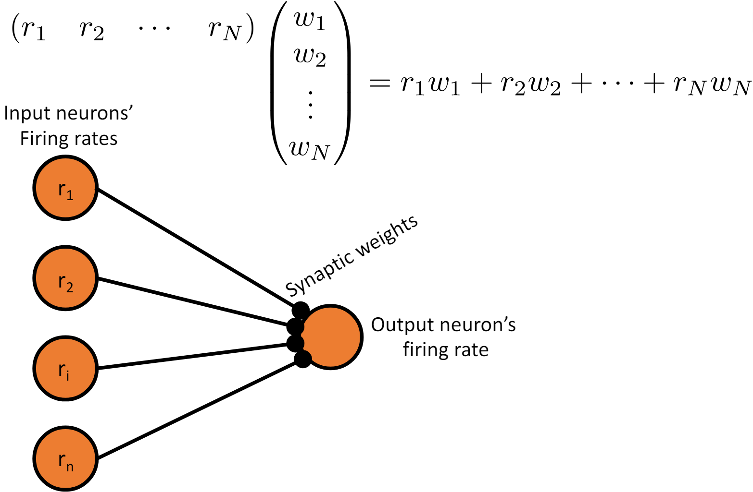

Example of Inner Product
Linear feedforward neural network

Slide 23
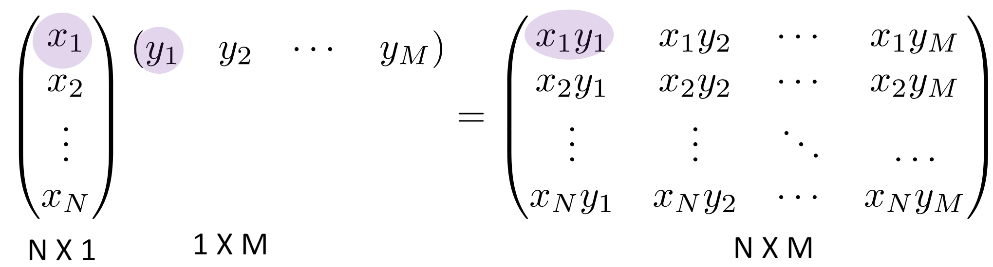
Example of Outer Product
Each element is the product of a pair of elements from the two vectors
The results measure all possible products between the components of the two vectors.
Notes:
Covariance Matrix microphone array system

Slide 24
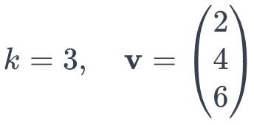
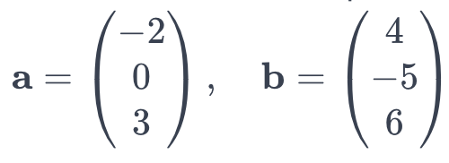
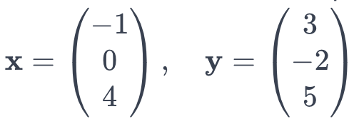
Examples
Q1. Multiply vector v by scalar k where
Q2. Find the inner product of vectors a and b where
Q3. Find the Hadamard product of vectors x and y where
Notes:
Here are some examples. But due to time constraints, we won't go into detail.

Slide 25
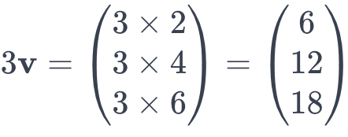
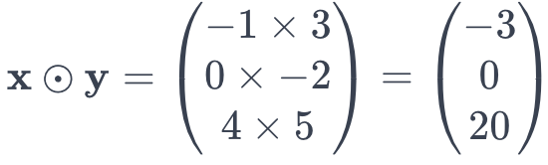
Examples
Q1. Multiply vector v by scalar k where
Solution 1
Q2. Find the inner product of vectors a and b where
Solution 2
Q3. Find the Hadamard product of vectors x and y where
Solution 3

Slide 26
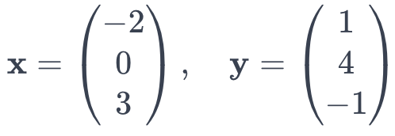
Examples
Q4. Find the outer product of vectors x and y where

Slide 27
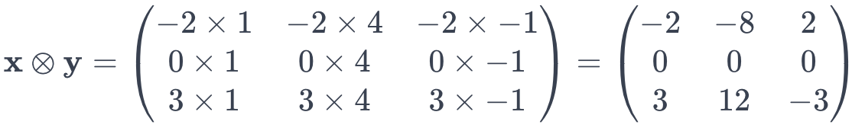
Examples
Q4. Find the outer product of vectors x and y where
The outer product x ⊗ y is calculated by multiplying each element of x with each element of y, leading to a 3×3 matrix. Therefore
Solution:

Slide 28
Content
Vector
Definition
Properties
Operations
Matrix
Definition
Properties
Operations

Slide 29
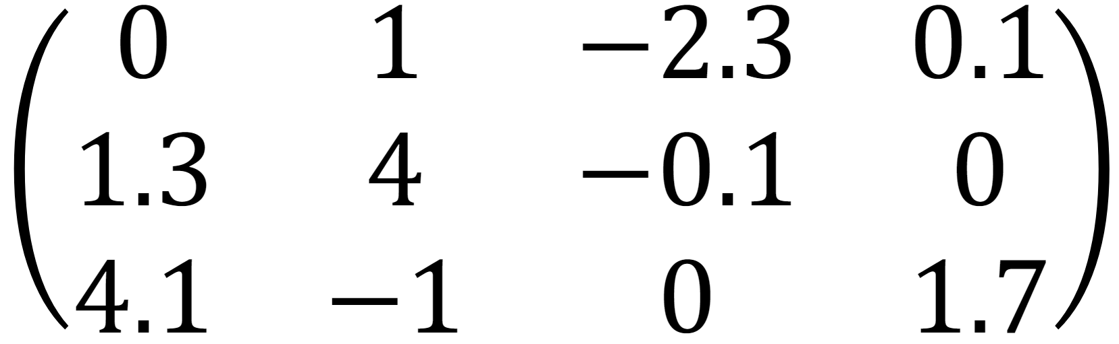
What is a Matrix?
A matrix is a rectangular array of numbers.
The size of a matrix is given by the (row dimension)×(column dimension), say 3×4 for the bellowing example.
$A_{i, j}$ is the element at the i-th row and j-th column.
Two matrices are the equal (=) if they have the same size and all corresponding entries are equal.
A =

Slide 30
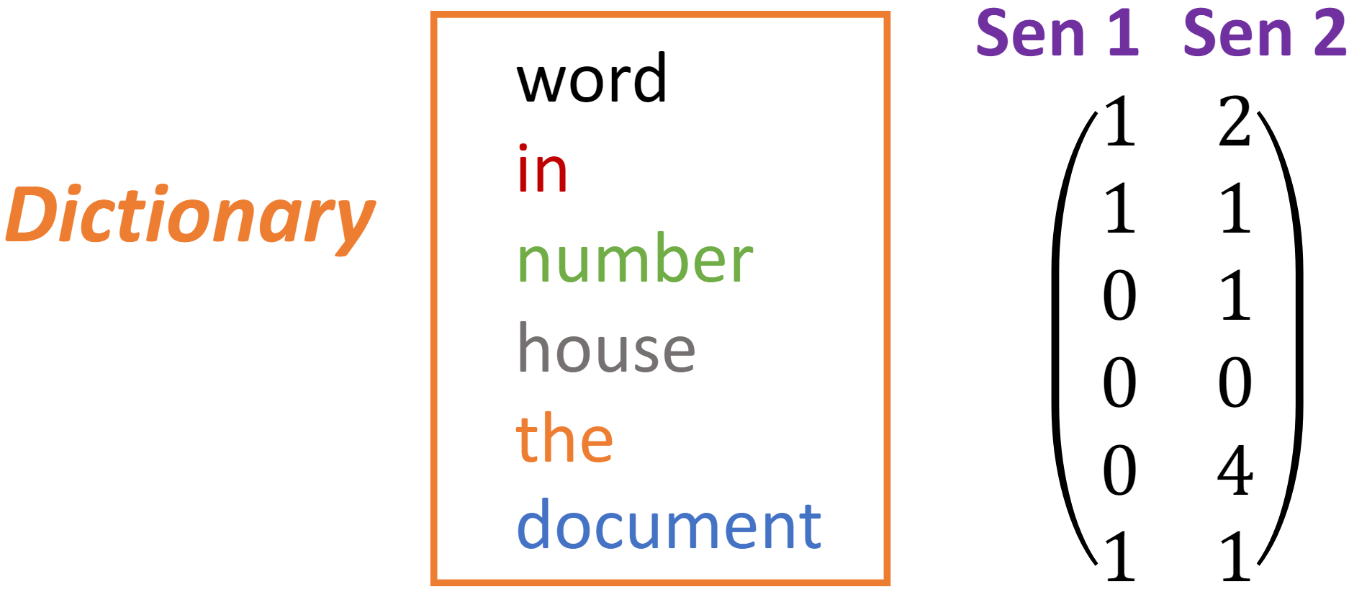
What is a Matrix?
A matrix is a rectangular array of numbers.
The size of a matrix is given by the (row dimension)×(column dimension), say 3×4 for the bellowing example.
$A_{i, j}$ is the element at the i-th row and j-th column.
Two matrices are the equal (=) if they have the same size and all corresponding entries are equal.
A =
Example of Matrix used in Machine Learning

Slide 31
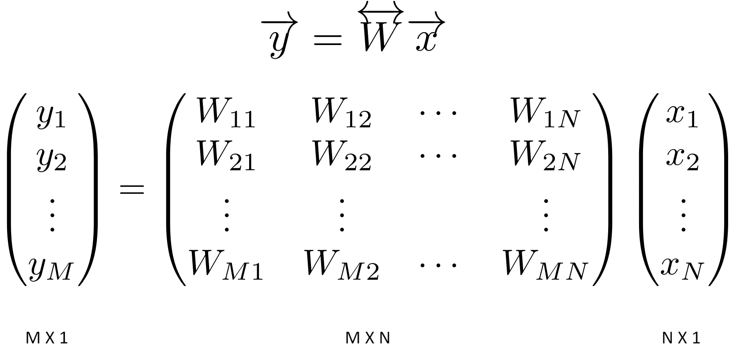
Matrix Arithmetic
Matrix times a Vector
Inner product interpretation: The i-th element of y is the dot product of the i-th row of W with x.

Slide 32
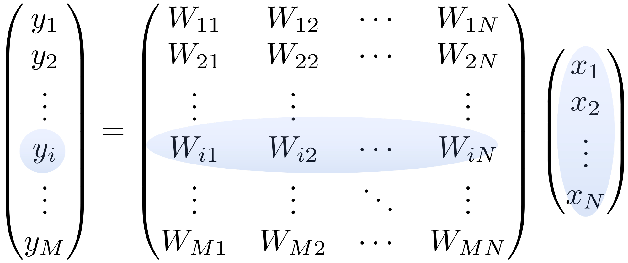
Example of Inner Product
Matrix times a Vector
The i-th element of y is the dot product of the i-th row of W with x.

Slide 33
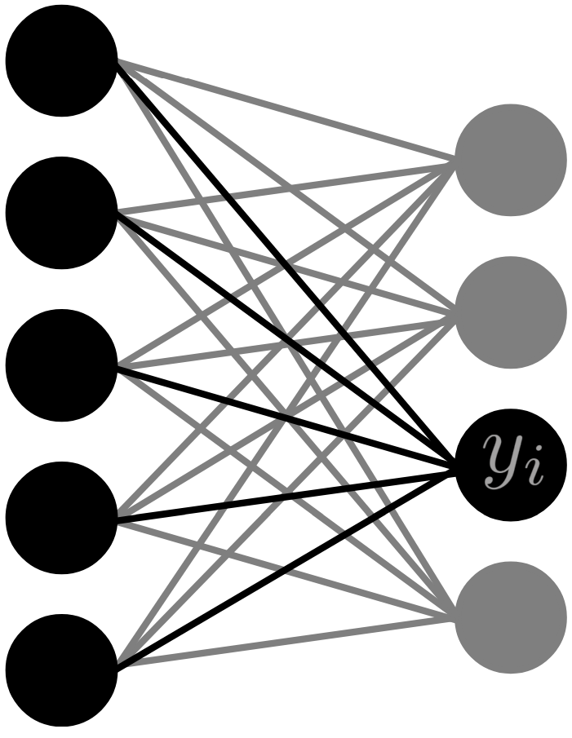
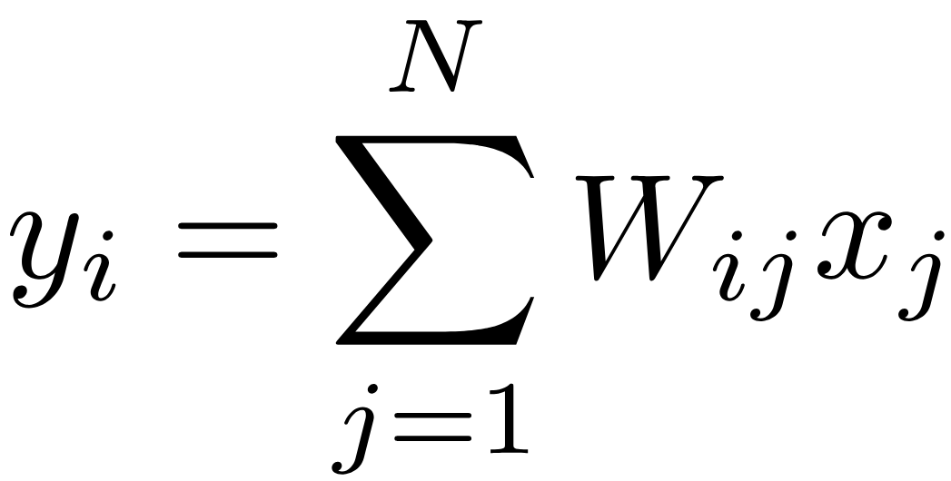
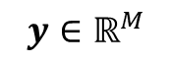
Example of Inner Product
Two-layer linear network
What is the response of element $y_{i}$ of the second layer?
$$x∈ℝ^{N}$$
$$W∈ℝ^{M×N}$$
$$y∈ℝ^{M}$$

Slide 34
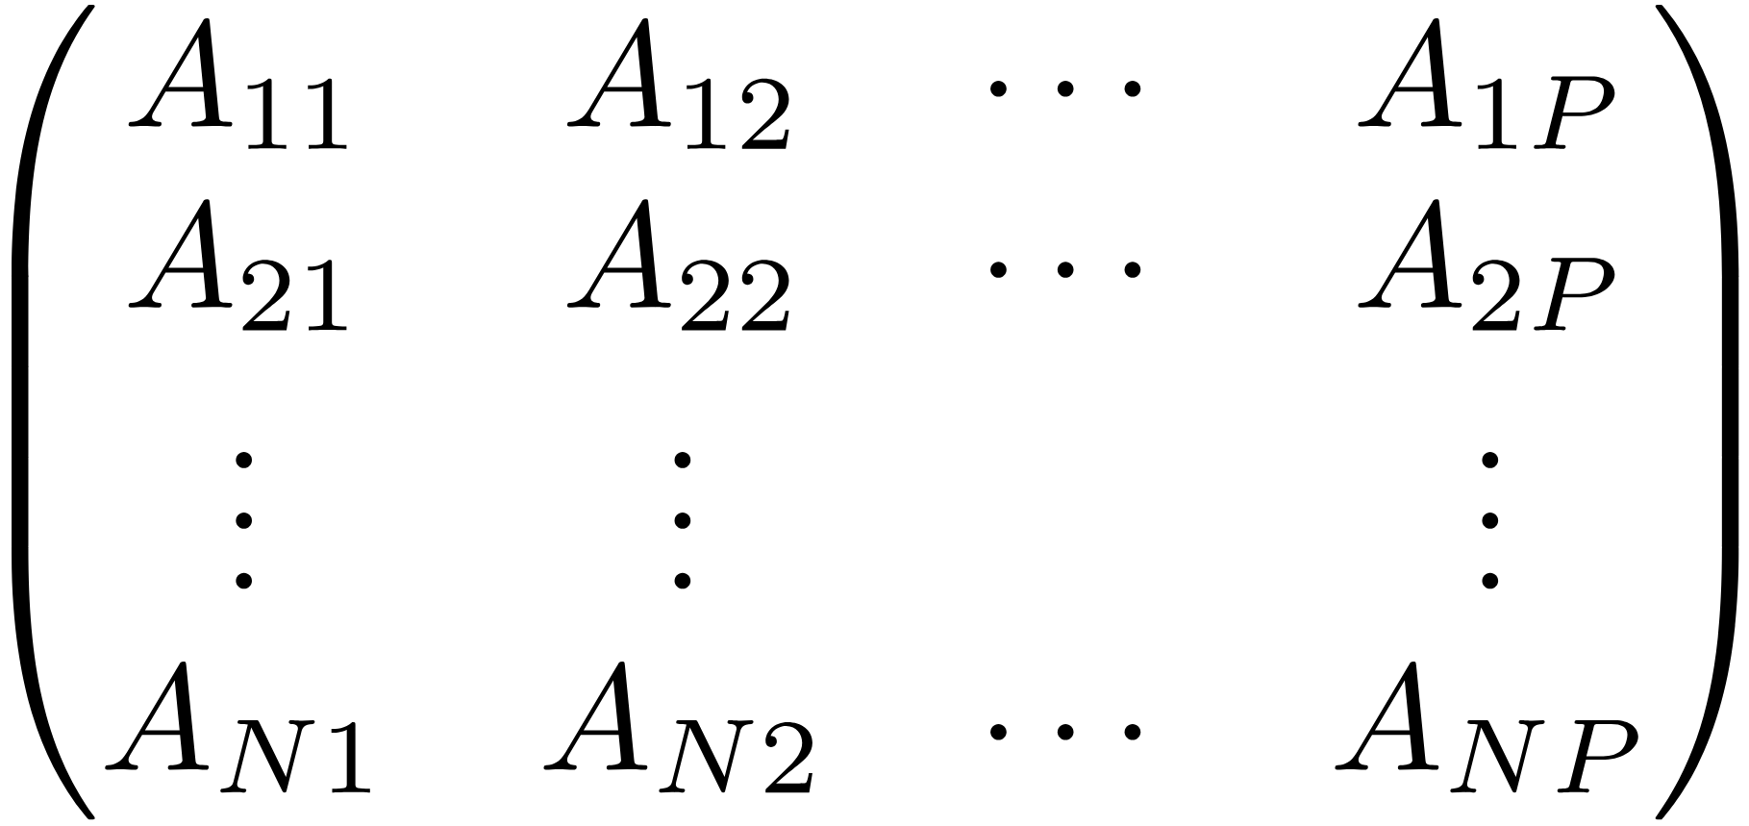
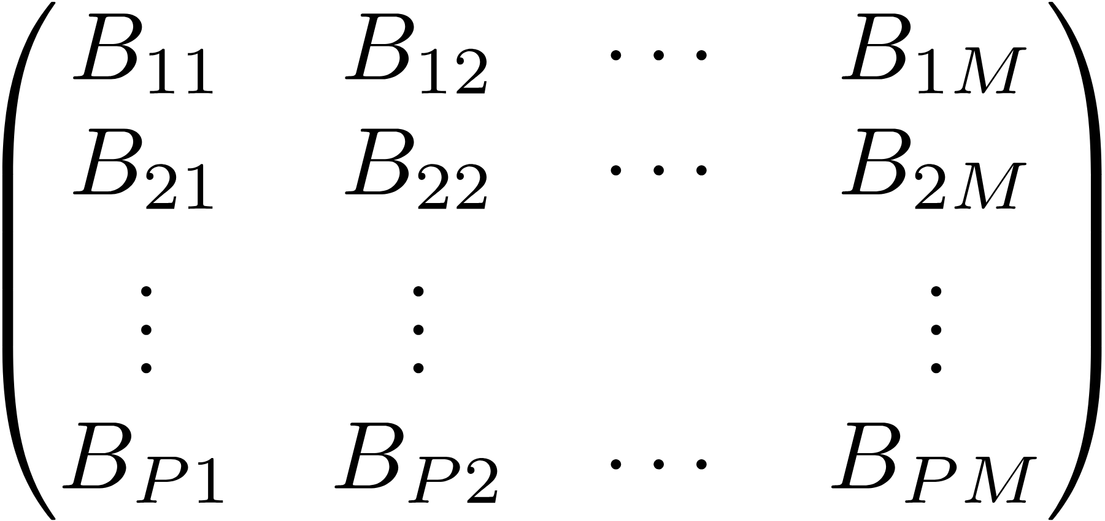
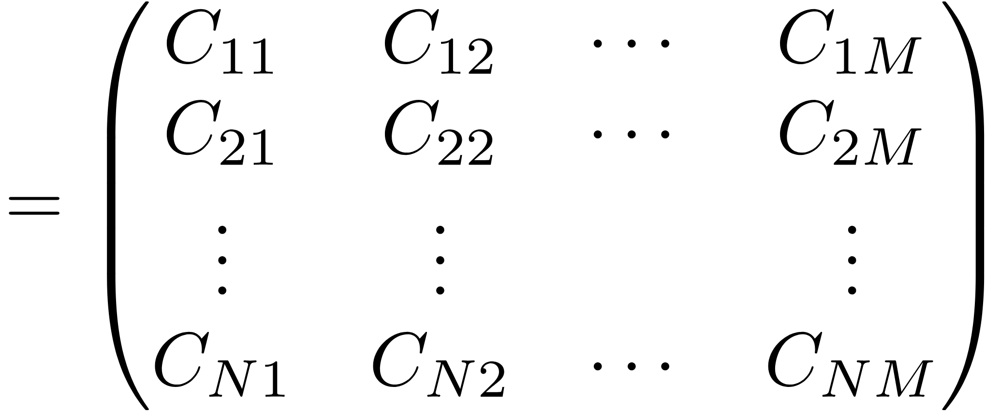
Matrix Arithmetic
Matrix times a Matrix
$$A∈ℝ^{N×P}$$
$$B∈ℝ^{P×M}$$
$$C∈ℝ^{N×M}$$
The column size of the matrix $A$ must equal to the row size of the matrix $B$
Matrix multiplication doesn’t (generally) commute, $AB ≠ BA$

Slide 35
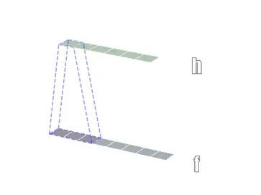
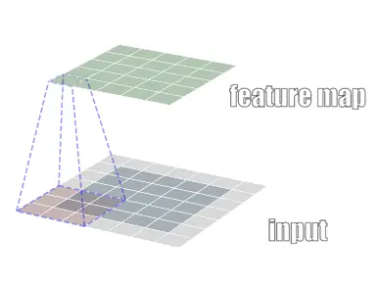
Could the convolution operation represent in a matrix multiplication form?
1-D convolution
2-D convolution

Slide 36
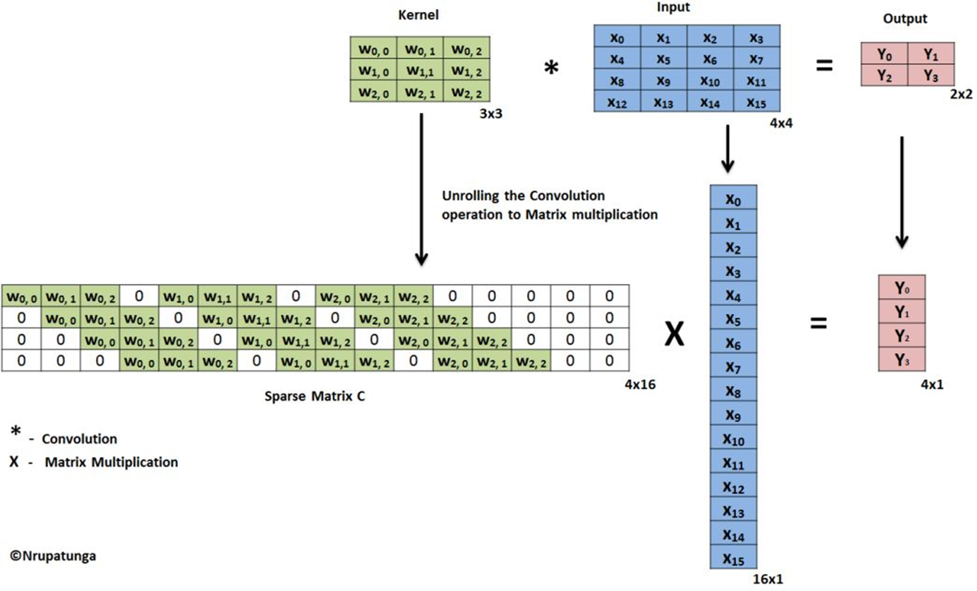
Could the convolution operation represent in a matrix multiplication form?

Slide 37
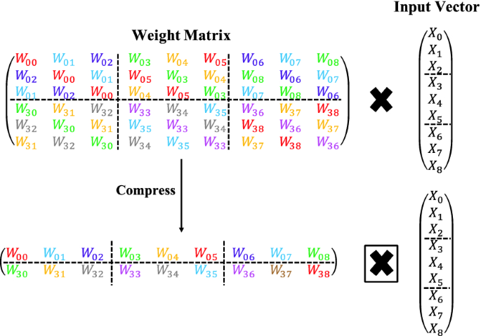
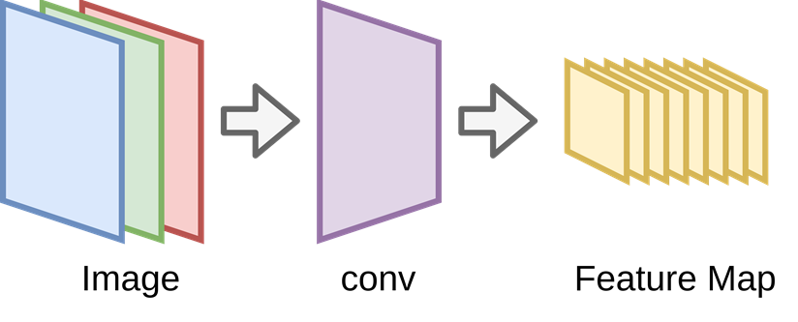
Why does the ConvNet work?
From above matrix multiplication view, we could regard the convolution operation as a special form of sparse multiplication!
Moreover, it possess a special structure——a block-circulant matrix with circulant blocks

Slide 38
Other Learning Resource:
Course:
MIT OpenCourseWare:
Linear Algebra: A comprehensive course with video lectures, notes, and assignments.
https://ocw.mit.edu/courses/18-06-linear-algebra-spring-2010/
Khan Academy:
Linear Algebra: Offers a series of video tutorials and exercises. https://www.khanacademy.org/math/linear-algebra
Book:
“Introduction to Linear Algebra” by Gilbert Strang: A widely-used textbook that balances theory and application.

Slide 39
Part 2: Review on Calculus

Slide 40
The Roles of Calculus in ML&DA
Optimization Problems in Training Models: Calculus is fundamental in solving optimization problems in a function form, which are at the heart of training machine learning models.

Slide 41
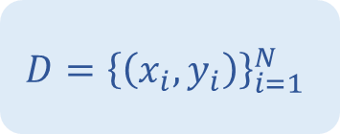
The Roles of Calculus in ML&DA
Optimization Problems in Training Models: Calculus is fundamental in solving optimization problems in a function form, which are at the heart of training machine learning models.
Example:
Given a dataset $D={\left\{\left(x_{i},y_{i}\right)\right\}}_{i=1}^{N}$ that contain $N$ paired of data.
Dataset
$$D={\left\{\left(x_{i},y_{i}\right)\right\}}_{i=1}^{N}$$

Slide 42
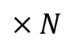
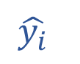
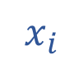
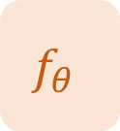
The Roles of Calculus in ML&DA
Optimization Problems in Training Models: Calculus is fundamental in solving optimization problems in a function form, which are at the heart of training machine learning models.
Example:
Given a dataset $D={\left\{\left(x_{i},y_{i}\right)\right\}}_{i=1}^{N}$ that contain $N$ paired of data.
During model training stage, we can use a machine learning model $f_{θ}$: $\hat{y_{i}}=f_{θ}(x_{i})$ to make prediction$\hat{y_{i}}$ for each data $x_{i}$.
Model Training Stage
Dataset
ML model
$$×N$$
$$D={\left\{\left(x_{i},y_{i}\right)\right\}}_{i=1}^{N}$$
Sample
$$f_{θ}$$
$$x_{i}$$
$$\hat{y_{i}}$$

Slide 43
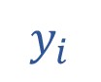

The Roles of Calculus in ML&DA
Optimization Problems in Training Models: Calculus is fundamental in solving optimization problems in a function form, which are at the heart of training machine learning models.
Example:
Given a dataset $D={\left\{\left(x_{i},y_{i}\right)\right\}}_{i=1}^{N}$ that contain $N$ paired of data.
During model training stage, we can use a machine learning model $f_{θ}$: $\hat{y_{i}}=f_{θ}(x_{i})$ to make prediction$\hat{y_{i}}$ for each data $x_{i}$.
The objective is to minimize a loss function $L$ that measures the difference (error) between the model's predictions $\hat{y_{i}}$and the ground truth value $y_{i}$, and backpropagate the error to the model.
Model Training Stage
Dataset
ML model
$$×N$$
error
$$D={\left\{\left(x_{i},y_{i}\right)\right\}}_{i=1}^{N}$$
Sample
$$f_{θ}$$
$$L$$
$$x_{i}$$
$$\hat{y_{i}}$$
$$y_{i}$$

Slide 44
Content
Function and Optimization
Definition of function
Optimization of a function
Function and Derivatives
Definition of derivatives
Properties of derivatives
Partial derivatives
Gradient and partial derivatives
Gradients of vectors and matrices

Slide 45
Content
Function and Optimization
Definition of function
Optimization of a function
Function and Derivatives
Definition of derivatives
Properties of derivatives
Partial derivatives
Gradient and partial derivatives
Gradients of vectors and matrices

Slide 46
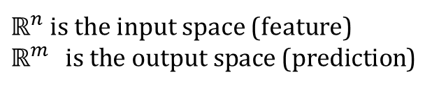




What is a function?
Definition of Function: a mathematical relationship that maps input data to output predictions based on certain parameters
Function $f_{θ}$
Input
$$x∈ℝ^{n}$$
Output
$$y∈ℝ^{m}$$
$ℝ^{n}$is the input space (feature)
$ℝ^{m}$is the output space (prediction)
$$f_{θ}:ℝ^{n}→ℝ^{m}$$

Slide 47

What is a function?
Definition of Function: a mathematical relationship that maps input data to output predictions based on certain parameters
Function $f_{θ}$
Input
$$x∈ℝ^{n}$$
Output
$$y∈ℝ^{m}$$
$ℝ^{n}$is the input space (feature)
$ℝ^{m}$is the output space (prediction)
$$f_{θ}:ℝ^{n}→ℝ^{m}$$
‘𝑦 is a function of 𝑥’ can be written with $y = f_{θ}\left(x\right)$
𝑥 is the independent variable while 𝑦 is the dependent variable
The input 𝑥 can be vectors and even matrices, so can the output 𝑓(𝑥)

Slide 48
Optimization of a function
Model in a function form:
$$y = f_{θ}\left(x\right)$$

Slide 49


Optimization of a function
Model in a function form:
$$y = f_{θ}\left(x\right)$$
Objective function: usually, objective function $L(θ)$ in ML quantifies the error between the model's predictions and the actual target values. Let’s take mean square value as an example here,
$$L\left(θ\right)=\frac{1}{m}\sum_{i=1}^{m}{{\left(f_{θ}\left(x_{i}\right)−y_{i}\right)}^{2}}$$
The function to be optimized is often parameterized by a set of parameters $θ.$

Slide 50

Optimization of a function
Model in a function form:
$$y = f_{θ}\left(x\right)$$
Objective function: usually, objective function $L(θ)$ in ML quantifies the error between the model's predictions and the actual target values. Let’s take mean square value as an example here,
$$L\left(θ\right)=\frac{1}{m}\sum_{i=1}^{m}{{\left(f_{θ}\left(x_{i}\right)−y_{i}\right)}^{2}}$$
The function to be optimized is often parameterized by a set of parameters $θ.$
Goal: find the best parameters $θ^{∗}$ that result in the lowest loss.
$$θ^{∗}=argmin_{θ} L(θ)$$

Slide 51

Visualizing the Loss Landscape
Visualizing the Loss Landscape of Neural Nets, NeurIPS 2018
Code link: https://github.com/tomgoldstein/loss-landscape

Slide 52
Content
Function and Optimization
Definition of function
Optimization of a function
Function and Derivatives
Definition of derivatives
Properties of derivatives
Partial derivatives
Gradient and partial derivatives
Gradients of vectors and matrices

Slide 53




What are Derivatives?
Definition: The derivative of $f(x)$ is the slope of tangent line (instantaneous rate of change) at $(x, f(x))$
$$f(x)$$
Tangent line
$$x$$
$$\frac{dy}{dx}=f^{′}\left(x\right)=\lim_{Δx→0}{\frac{f\left(x+Δx\right)−f(x)}{Δx}}$$

Slide 54



What are Derivatives?
Definition: The derivative of $f(x)$ is the slope of tangent line (instantaneous rate of change) at $(x, f(x))$
$$f(x)$$
Tangent line
$$x$$
$$\frac{dy}{dx}=f^{′}\left(x\right)=\lim_{Δx→0}{\frac{f\left(x+Δx\right)−f(x)}{Δx}}$$
Example: $y=x^{2}$
$$\frac{dy}{dx}=\lim_{Δx→0}{\frac{{\left(x+Δx\right)}^{2}−x^{2}}{Δx}}=\lim_{Δx→0}\left(2x+Δx\right)=2x$$
Also written as: $dy=2xdx$ (the differential $dy$ in terms of the differential $dx$)

Slide 55
What are Derivatives?
Definition: The derivative of $f(x)$ is the slope of tangent line (instantaneous rate of change) at $(x, f(x))$
$$f(x)$$
Tangent line
$$x$$
$$\frac{dy}{dx}=f^{′}\left(x\right)=\lim_{Δx→0}{\frac{f\left(x+Δx\right)−f(x)}{Δx}}$$
Example: $y=x^{2}$
$$\frac{dy}{dx}=\lim_{Δx→0}{\frac{{\left(x+Δx\right)}^{2}−x^{2}}{Δx}}=\lim_{Δx→0}\left(2x+Δx\right)=2x$$
Also written as: $dy=2xdx$ (the differential $dy$ in terms of the differential $dx$)
Used to estimate the output difference Δy in terms of a small input difference $Δx$

Slide 56

Properties of Derivatives
Single differentiable function:
For any constant 𝑐 and any differentiable function $f\left(x\right)$, it satisfies the following equation:
$$\frac{d\left[cf\left(x\right)\right]}{dx}=c⋅\frac{d[f(x)]}{dx}$$

Slide 57


Properties of Derivatives
Single differentiable function:
For any constant 𝑐 and any differentiable function $f\left(x\right)$, it satisfies the following equation:
$$\frac{d\left[cf\left(x\right)\right]}{dx}=c⋅\frac{d[f(x)]}{dx}$$

Slide 58



Properties of Derivatives
Single differentiable function:
For any constant 𝑐 and any differentiable function $f\left(x\right)$, it satisfies the following equation:
$$\frac{d\left[cf\left(x\right)\right]}{dx}=c⋅\frac{d[f(x)]}{dx}$$
Examples:
$\frac{d\left[5x^{3}\right]}{dx}=5⋅3x^{2}=15x^{2}$
$\frac{d\left[\log_{4}x\right]}{dx}=4^{x}ln4$
$\frac{d\left[−4e^{2x}\right]}{dx}=−4⋅\frac{d\left[{\left(e^{2}\right)}^{x}\right]}{dx}=−4e^{2x}ln\left(e^{2}\right)=−8e^{2x}$
$\frac{d3}{dx}=0$

Slide 59



Properties of Derivatives
For any two differentiable functions $f\left(x\right)$ and $g(x)$, they satisfies the following rules:
Example: function (top), derivatives (bottom)
Sum and Difference Rules.

Slide 60

Properties of Derivatives
For any two differentiable functions $f\left(x\right)$ and $g(x)$, they satisfies the following rules:
Example: function (top), derivatives (bottom)
Sum and Difference Rules.
Product Rule.

Slide 61





Properties of Derivatives
For any two differentiable functions $f\left(x\right)$ and $g(x)$, they satisfies the following rules:
Example: function (top), derivatives (bottom)
Sum and Difference Rules.
Product Rule.
Quotient Rule.

Slide 62




Properties of Derivatives
For any two differentiable functions $f\left(x\right)$ and $g(x)$, they satisfies the following rules:
Example: function (top), derivatives (bottom)
Sum and Difference Rules.
Product Rule.
Quotient Rule.
Chain Rule.

Slide 63






Partial derivatives (for multivariate functions)
A function may have multiple variables, e.g.,
$$f\left(x,y\right)=x^{2}y$$
Definition: A partial derivative of a function of several variables is its derivative with respect to one of those variables, with the others held constant
Usually denoted by
$$f\left(x,y\right)=100−x^{2}−y^{2}$$
$$\frac{∂f}{∂x}$$
$$\frac{∂f}{∂y}$$
or
$$\frac{∂f}{∂x}=−2x$$
$$\frac{∂f}{∂y}=−2y$$

Slide 64






Gradient and partial derivatives
Partial derivatives
Gradient
For f:$ℝ^{n}→ℝ$
Get the partial derivatives and collect them in the row vector.
$$\frac{∂f}{∂x_{1}}=\lim_{h→0}{\frac{f\left(x_{1}+h, x_{2}, …x_{n}\right)−f(x)}{h}}$$
$$\frac{∂f}{∂x_{2}}=\lim_{h→0}{\frac{f\left(x_{1}, x_{2}+h, …x_{n}\right)−f(x)}{h}}$$
$$∇_{x}f=\frac{df}{dx}=\left(\frac{∂f\left(x\right)}{∂x_{1}} …\frac{∂f\left(x\right)}{∂x_{n}}\right)∈ℝ^{1×n}$$
$$…$$
$$\frac{∂f}{∂x_{n}}=\lim_{h→0}{\frac{f\left(x_{1}, …,x_{n−1},x_{n}+h\right)−f(x)}{h}}$$

Slide 65



Gradient and partial derivatives
Useful rules of partial differentiation
Product rule
$$\frac{∂\left(f\left(x\right)g\left(x\right)\right)}{∂x}=\frac{∂f\left(x\right)}{∂x}g\left(x\right)+f\left(x\right)\frac{∂g\left(x\right)}{∂x}$$
Sum rule
$$\frac{∂\left(f\left(x\right)+g\left(x\right)\right)}{∂x}=\frac{∂f\left(x\right)}{∂x}+\frac{∂g\left(x\right)}{∂x}$$
Chain rule
$$\frac{∂g\left(f(x)\right)}{∂x}=\frac{∂g}{∂f}\frac{∂f}{∂x}$$
These include the sum rule, product rule, quotient rule, chain rule, and power rule.

Slide 66

The training process using BP algorithm

Slide 67
Other Learning Resource:
Course:
MIT OpenCourseWare:
Single Variable Calculus: Provides lecture notes, assignments, and exams.
https://ocw.mit.edu/courses/18-01sc-single-variable-calculus-fall-2010/
Khan Academy:
Calculus: Offers comprehensive video tutorials and practice exercises https://www.khanacademy.org/math/calculus-1
Book:
Stewart, J. (2010). Calculus: Concepts and contexts. Toronto: Cengage Learning.
A widely used textbook that covers all aspects of single-variable and multivariable calculus with clear explanations, examples, and exercises.

Slide 68
Thanks for attention!
Xiang Hao
Department of Data Science and Artificial Intelligence
The Hong Kong Polytechnic University
xiang.yan@connect.polyu.hk

